Slide 1
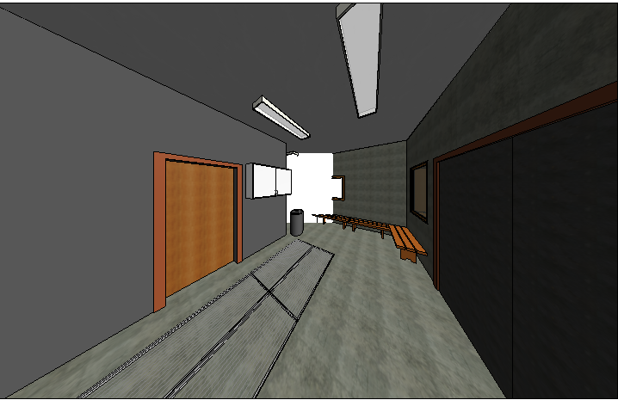
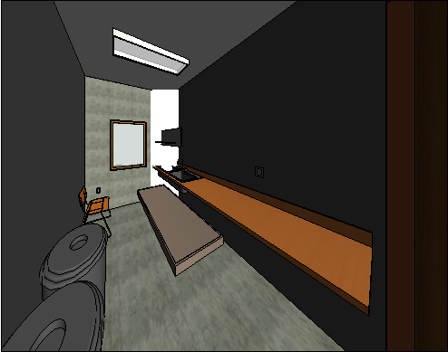
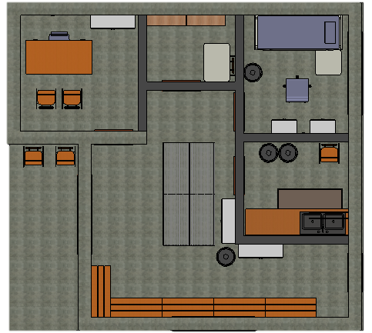
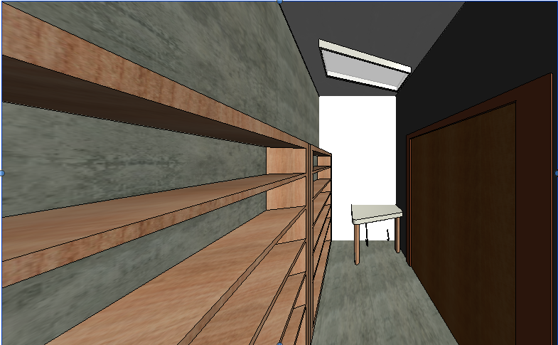
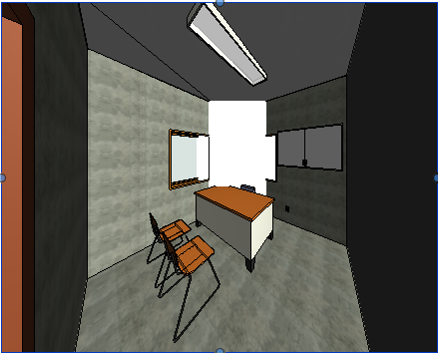
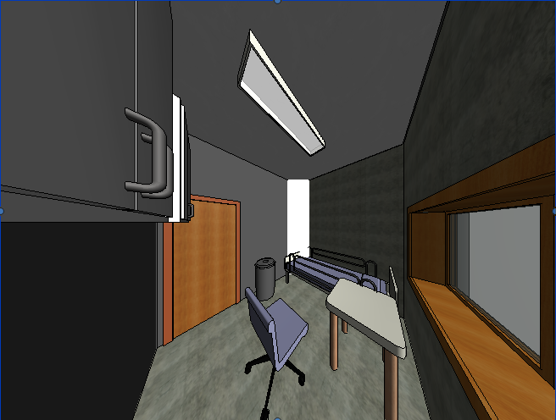
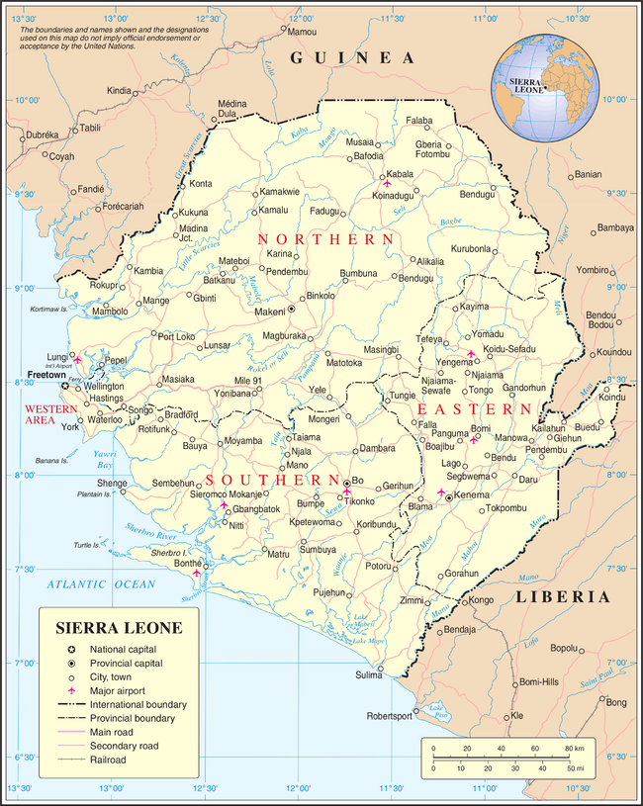
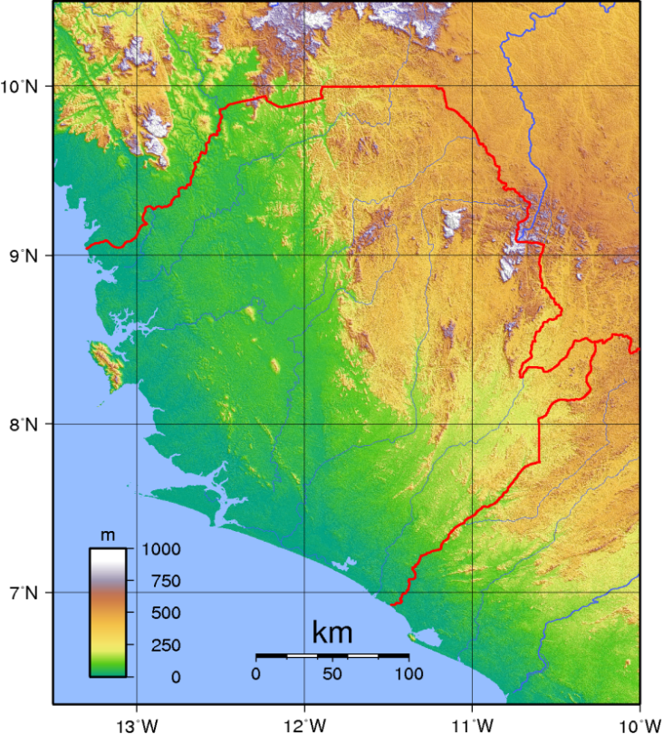
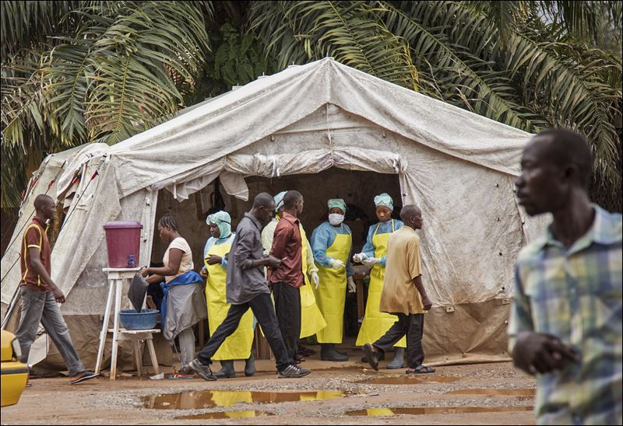
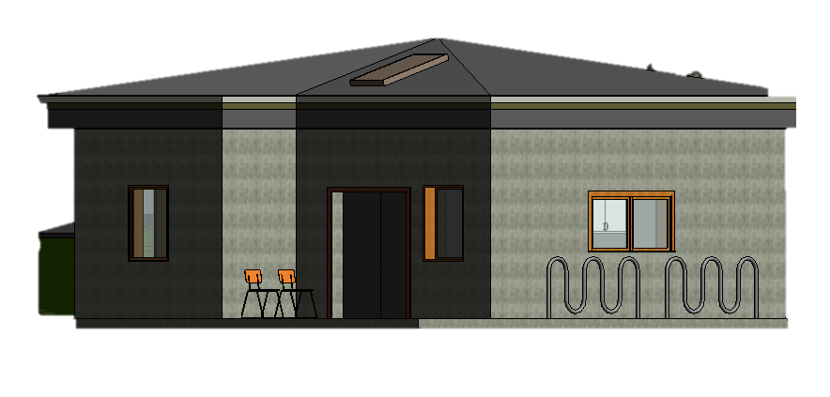
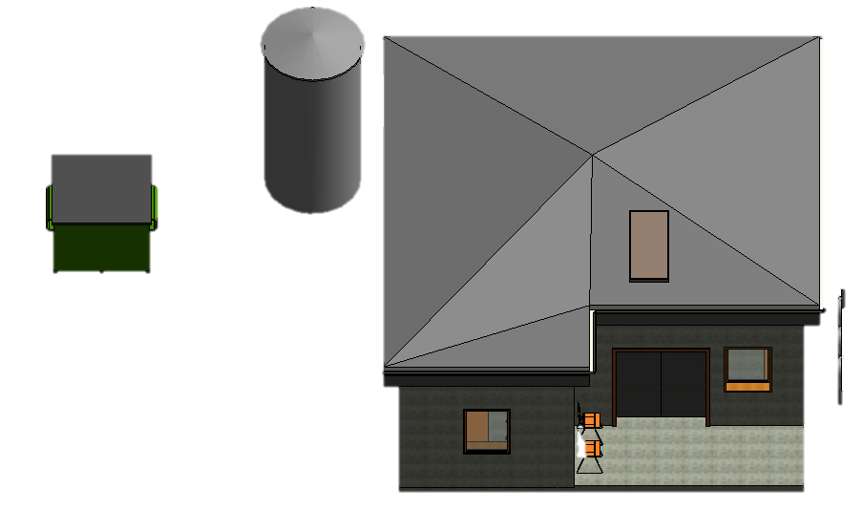
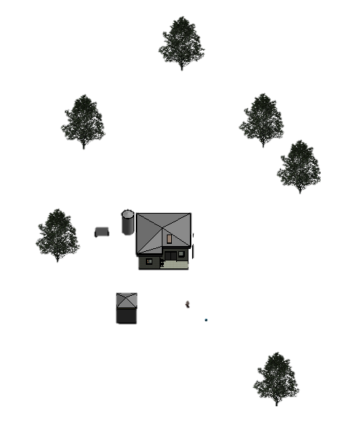
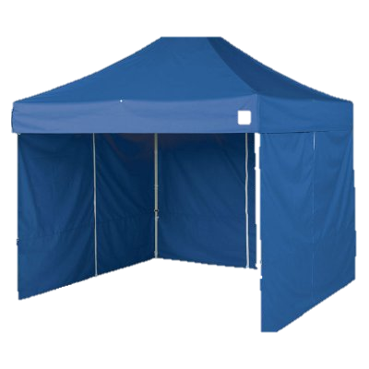
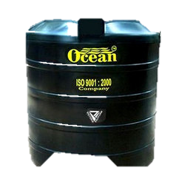
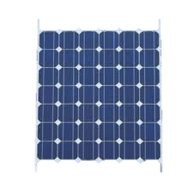
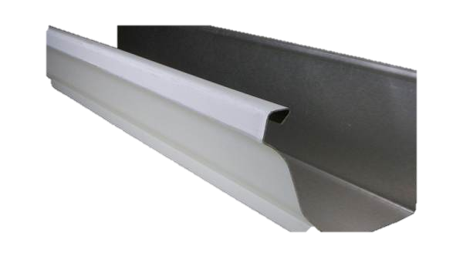
Waiting
Sterilization
Floor Plan Overview
Store
Consultation
Observation
Project Overview
Site Description
Sierra Leone is located on the west coast of Africa and has a land area of 71,620 km²
50 treatment centers a tropical climate with rainy and dry seasons
The geography varies with mountains, plateaus and coastal regions
Centers should be strategically placed to utilize natural resources
General Restrictions
Materials are lifted by hand: No cranes
Limited varieties of concrete, masonry, lumber, tin roofing sheets and Steel (pins and rods)
Human and Environmental Interests
Screen all patients for EBOLA in triage tent and redirect them to EBOLA center if necessary
To treat patients without EBOLA
Bicycle facility and rainwater management
Maximum use of daylight with minimum natural heating
Design Specifications
East View With Elevations
General Guidelines
Corrugated steel roofs lined with basic gutters
Basic doors and windows that open to allow optimum ventilation
Medical equipment suitable for basic primary care
3 Kilowatt photovoltaic system
Limited use of resources: natural and man made
Sinks accompanied by a drainage system
Basic Map of Sierra Leone
Site View Focusing on Treatment Center
Gutters
Key Design Specifications
No ceiling - save material. A steel roof with a thatched roof 1 foot above for natural ventilation
Rainwater collection system with black storage tank and passive solar cover
Small water heater powered by PV which heats the rain basin water
Wooden benches and plastic chairs, which are easy to sterilize
Large washable plastic mats in the center of the waiting room to be used for occupational/physical therapy
10ft by 10ft tent placed far and not directly in front of center
km²
Topography Map
Village Huts
Bike Rack
Aerial View
Proposed Design of Primary Care Facility in Sierra Leone
Andres Hartman, Eric Borkowicz, Luke Yanek
EGR 343: Green Architectural Engineering
Elizabethtown College, Elizabethtown, PA
Triage Tent
Thatch Roofing
Black Water Storage Tank
3 KW Producing PV
Basic Gutter

